Slide 1


Big Data Analytics & Machine Learning:
Spark MLlib
BIG DATA COMPUTING A PRACTICAL APPROACH
BIG DATA ANALYTICS & MACHINE LEARNING
DBRAIT-24/04/2019

Slide 2
Uber Taxi Trip Data Analysis
Dataset Description:
The dataset has been taken from the Uber trip dataset which FiveThirtyEight obtained from the NYC Taxi & Limousine Commission. The dataset comprises of the GPS sensor data streamed from the Uber taxies before customer pickups stored as a static data in a CSV file from April to September 2014.

Slide 3
Use case
Uber wants to make use of an-end-to-end big data machine learning pipeline to perfect its processes for finding the optimal positioning of cars to maximize profits.

Slide 4
Objectives
Identify and output which hours of the day had the highest pickups
Output the clusters which had the highest volumes of taxi booking requests
Aggregate and output the number of taxi booking pickups per cluster

Slide 5
Features
4 attributes
Attribute Name | Attribute Description
Date Time | date and time of the Uber pickup
Lat | Latitude of Uber pickup
Lon | longitude of the Uber pickup
Base | TLC base company affiliated with the Uber pickup

Slide 6
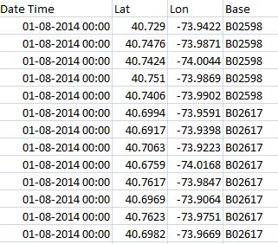
Sample Dataset

Slide 7
Outline
We will make use of Apache Spark’s machine learning library’s K-means clustering algorithm to cluster Uber data based on location.

Slide 8
Background
K-means, a commonly used clustering algorithms that clusters the data points into a predefined number of clusters (k).
K-means algorithm begins by initializing all the coordinates to k number of centroids.
With every pass of the algorithm, each point is assigned to its nearest centroid based on some distance metric, which is usually Euclidean distance.
The centroids are then updated to be the “centers” of all the points assigned to it in that pass. This repeats until there is a minimum change in the centers.

Slide 9
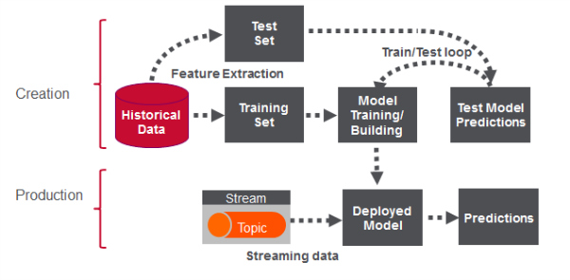
Big Data Pipeline for Uber Taxi Trip Data Analysis using Spark MLlib

Slide 10
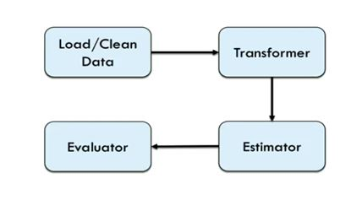
Spark MLlib Machine learning Pipeline

Slide 11
Loading the Dataset:
From an input CSV file to a Spark Dataframe
val df: Dataset[Uber] = spark.read.option("inferSchema", "false").schema(schema).csv("/home/iitp/spark-2.2.0-bin-hadoop2.6/Uber/uber.csv").as[Uber]
Data Frame
Load Data

Slide 12
Features Extraction
Features are transformed and put into Feature Vectors, which are vectors of numbers representing the value for each feature.
We use a VectorAssembler for transforming and returning a new DataFrame with all of the feature columns in a vector column.
val featureCols = Array("lat", "lon")
val assembler = new VectorAssembler().setInputCols(featureCols).setOutputCol("features")
val df2 = assembler.transform(df)

Slide 13
Features Extraction
Load Data
transform
DataFrame
Features
dt | lat | lon | base | Features
2014-08-01 | 40.729 | -73.9422 | B02598 | [40.729,-73.9422]

Slide 14
Model Training
Create a KMeans object
set the parameters to define:
  the number of clusters
  the maximum number of iterations to determine the clusters,
fit the model to the input data.
val Array(trainingData, testData) = df2.randomSplit(Array(0.7, 0.3), 5043) val kmeans=new KMeans().setK(20).
setFeaturesCol("features"). setMaxIter(5)
val model = kmeans.fit(trainingData)
println("Final Centers: ")
model.clusterCenters.foreach(println)

Slide 15
Model Training
Load Data
Transform
DataFrame
Features
fit
Model
dt | lat | lon | base | Features
2014-08-01 00:00:00 | 40.729 | -73.9422 | B02598 | [40.729, -73.9422]

Slide 16
Model Evaluation
We use the model to get the clusters for test data in order to further analyze the clustering.
val categories = model.transform(testData) categories.show

Slide 17
Model Evaluation
Load Data
DataFrame
Transform
Features
fit
Model
Transform
Predictions
dt | lat | lon | base | Features | prediction
2014-08-01 00:00:00 | 40.729 | -73.9422 | B02598 | [40.729, -73.9422] | 1

Slide 18
Analysis Operations
Output which hours of the day and which cluster had the highest number of pickups?
categories.select(hour($"dt").alias("hour"),$"prediction").groupBy("hour","prediction").agg(count("prediction").alias("count")).orderBy(desc("count")).show
Output:
hour | prediction | Count
17 | 7 | 6826
17 | 0 | 6775
18 | 7 | 6542
21 | 7 | 6513
18 | 0 | 6482

Slide 19
Analysis Operations
Output the total number of pickups occurred in each cluster
categories.groupBy("prediction").count().show()
Output:
prediction | Count
0 | 87922
1 | 7956
2 | 659
3 | 11580
4 | 5220
5 | 34734

Slide 20
Analysis Operations
Output the total number of pickups occurred in each cluster
categories.groupBy("prediction").count().show()
Output:
prediction | Count
0 | 87922
1 | 7956
2 | 659
3 | 11580
4 | 5220
5 | 34734

Slide 21
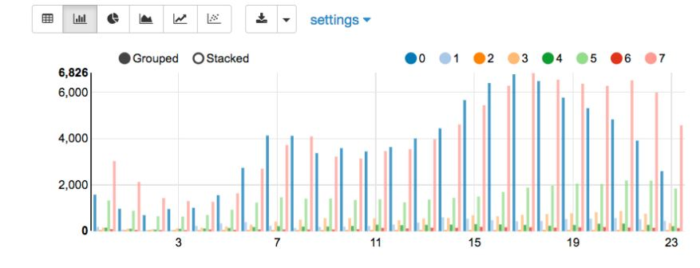
Zeppelin Integration
With a Zeppelin notebook, we can also display query results in bar charts or graphs. Below, the x-axis is the hour, the y-axis the count, and the colors are the different clusters.
z.show(categories.select(hour($”dt”).alias(“hour”),$”prediction”).groupBy(“hour”,”prediction”).agg(count(“prediction”)).alias(“count”)).orderBy(“hour”,”prediction”))

Slide 22
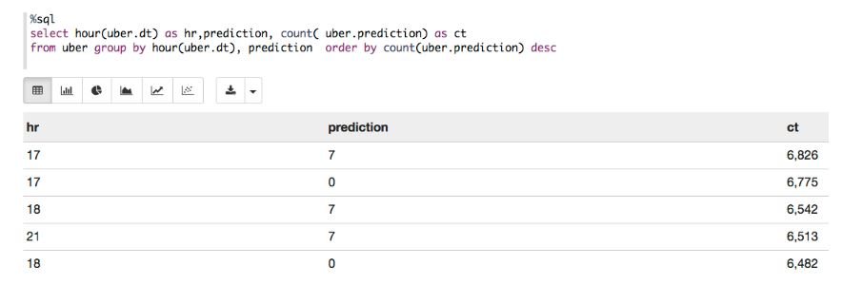
SQL Statements in Zeppelin
We can can register a DataFrame as a temporary table using a given name, like, df.registerTempTable("uber"),
Run SQL statements using the SQL methods provided by sqlContext. An example is shown below in a Zeppelin notebook.

Slide 23
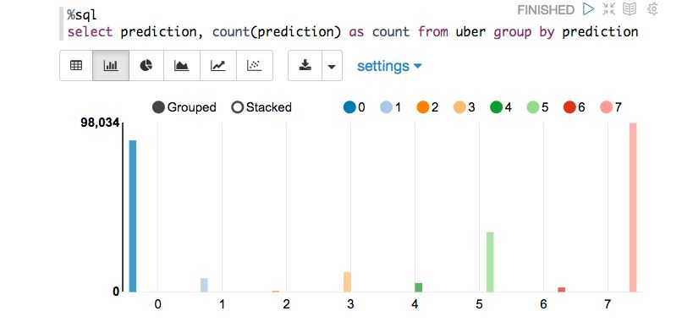
SQL Statements in Zeppelin

Slide 24
References
https://acadgild.com/blog/how-to-integrate-spark-with-zeppelin

Slide 25
Thank You

